Slide 1

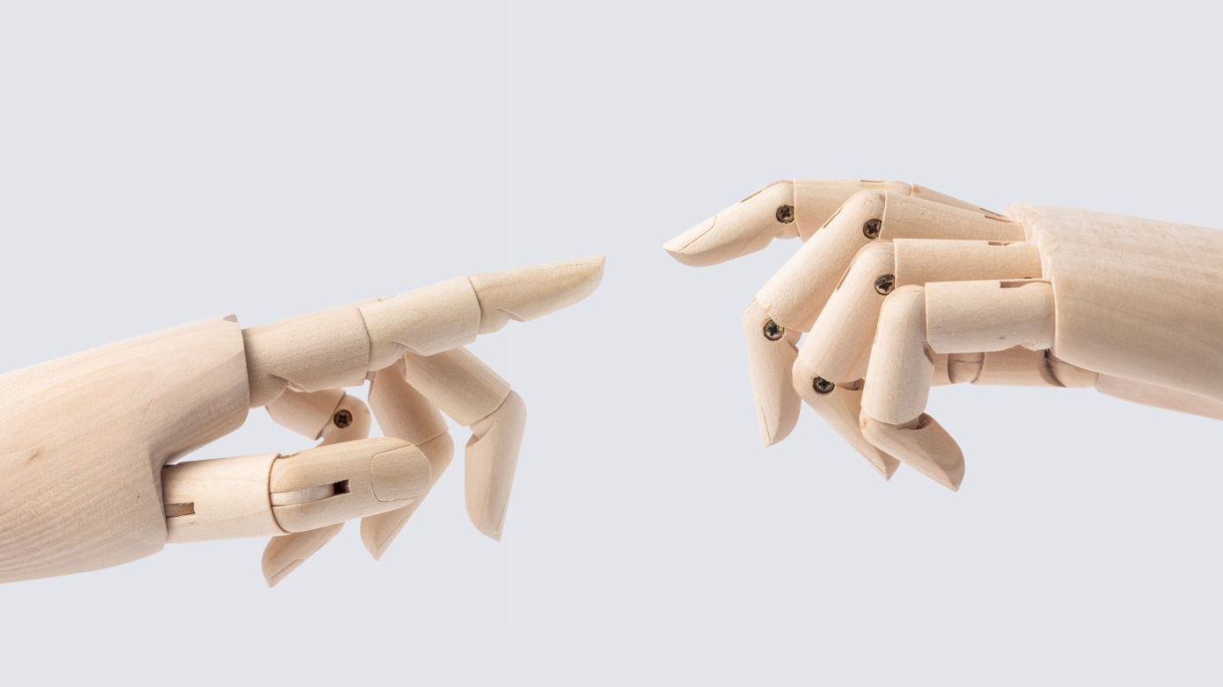

Design of Affordable Myoelectric Prosthetic Arm
By : Samarth Patel (14628071)
Saurabh Pethkar (14652249)
Ohsung Kwon (14680477)
Course: MEM-675 Medical Robotics I (Spring 2024)
Professors: Prof. Kim, Euisun
Prof. Han, Li-Hsin

Slide 2

Motivation
Many prosthetic devices are expensive and not accessible to people in developing countries.
There is a need for low-cost, functional prosthetic limbs to improve the quality of life for amputees.
Advancements in 3D printing technology provide an opportunity to create affordable and customizable prosthetic devices.
This project aims to design and build a low-cost, 3D printed myoelectric prosthetic arm controlled by muscle contractions, making advanced prosthetics accessible to a broader population.

Slide 3

Market Research
Company | Approximate Cost Range
Össur | $20,000 - $60,000
Touch Bionics | $60,000 - $100,000+
Hanger Clinic | $20,000 - $70,000
Fillauer | $30,000 - $80,000
Ottobock | $30,000 - $100,000+
WillowWood | $20,000 - $60,000
Aspect | Extracted Data
Average Cost of Advanced Prosthetics | $20,000 - $100,000+
Percentage of Amputees Unable to Afford Prosthetics | Approx. 75% in developing countries, 30%+ in developed countries
Impact on Healthcare Budgets | Advanced prosthetics account for a significant portion of healthcare expenditures, limiting resources for other essential services
Geographic Disparities in Access | Access to advanced prosthetics is disproportionately limited in rural and underserved areas
Economic Implications | High costs of advanced prosthetics contribute to economic disparities and hinder socio-economic mobility for individuals with limb differences

Slide 4
Project Market Position
Current commercial myoelectric prosthetics, such as the Bebionic 3 and i-Limb digits, are expensive and less accessible. The project aims to offer a competitive alternative with similar functionalities at a fraction of the cost​.
The proposed 3D printed prosthetic arm aims to keep the material cost under $500, significantly lowering the barrier to entry for users who need affordable solutions .
Primary target includes amputees and individuals born without limbs who cannot afford high-cost prosthetics.
Utilization of 3D printing technology to rapidly prototype and produce prosthetic components at a lower cost and Innovations in materials and design improvements can enhance the durability and functionality of the prosthetic arm.

Slide 5
Insights on our Design
Mechanical Design & Actuation:
Presents 3D printable designs with electronically actuated components.
Electrical Design & Control
Involves electromyography sensing for capturing muscle movements.
Modularity & Customization:
Features designs that allow for different modular configurations to accommodate various types of amputations.
Uses servo motors controlled by myoelectric signals for movement.
Illustrates the inclusion of tendon actuation systems, geared wrist and elbow mechanisms, and finger actuation using artificial tendons.
Utilizes microprocessors for signal processing and control of actuation.
Incorporates voltage regulators and power supplies for efficient energy management.
Demonstrates adjustability in components like the thumb and wrist to fit user-specific needs.
Manufacturing & Assembly:
Emphasizes the use of 3D printing for rapid and cost-effective production.
Details assembly techniques and component integration, ensuring a cohesive and functional unit.

Slide 6
Methodology
Literature Review
Designing
Numerical Analysis
Market Survey
User Feedback
Manufacturing

Slide 7
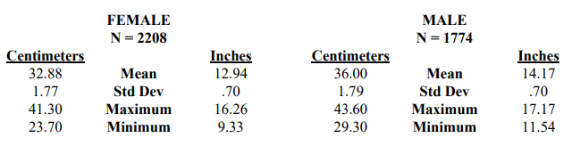
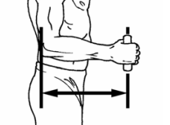
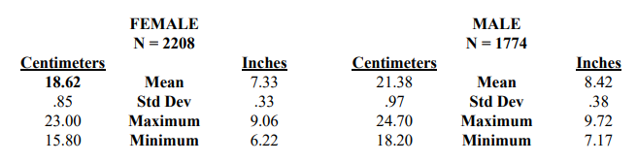
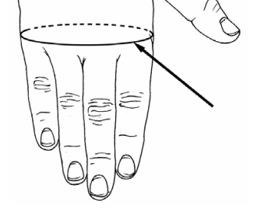
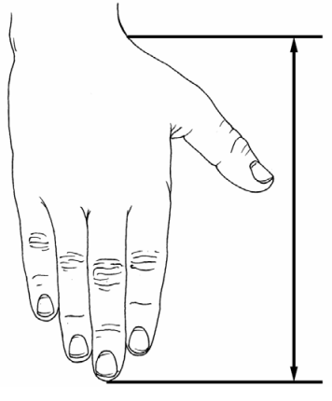
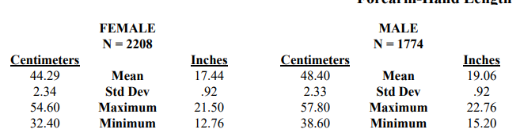
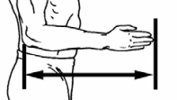
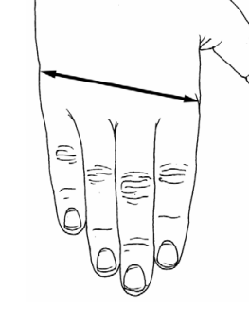
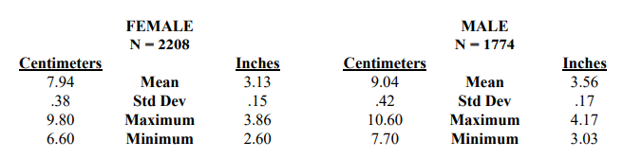
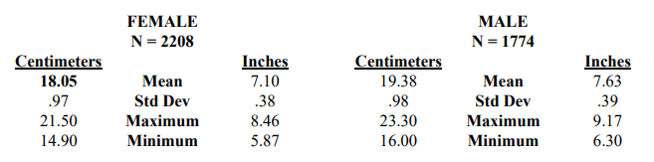
Literature Review
Elbow-Wrist Length
Hand Circumference
Forearm-Hand Length
Hand Breadth
Hand Length

Slide 8
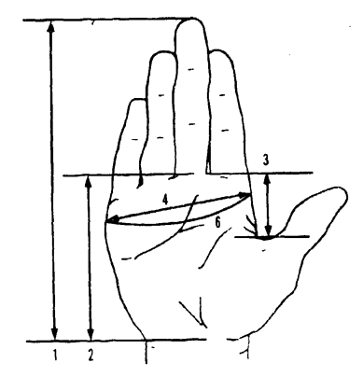
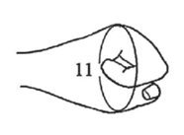
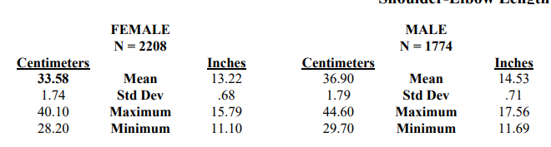
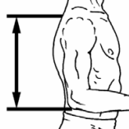
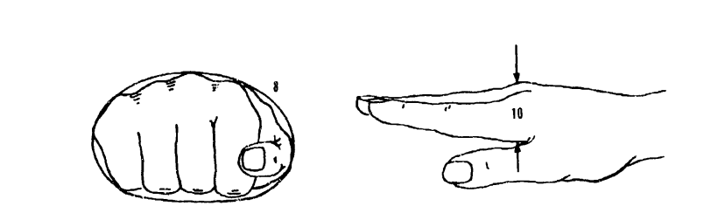
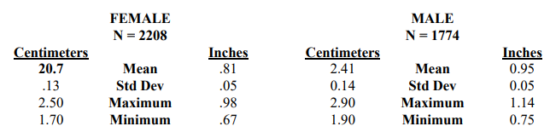
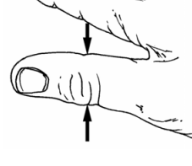
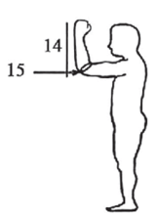
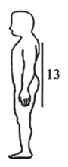
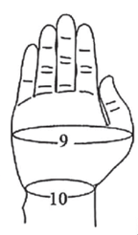
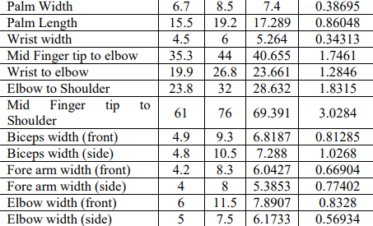
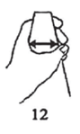
Shoulder Elbow Length
Thumb Breadth
Features | Min | Max | Mean | STD Deviation
Anthropometric hand dimensions.

Slide 9
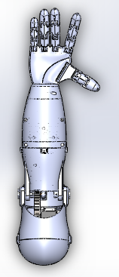
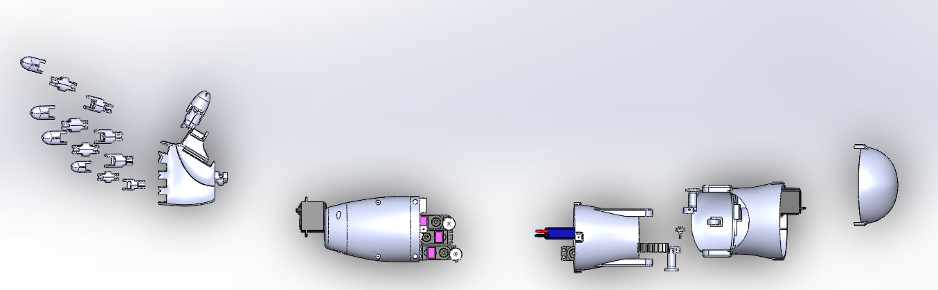
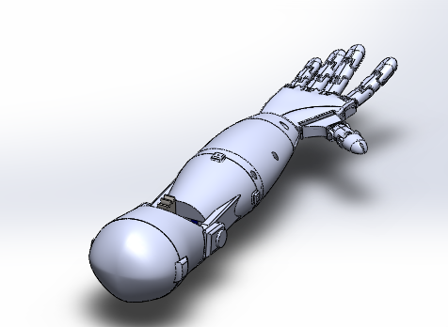
Exploded view of Assembly
Top View of Assembly
Isometric View of Assembly

Slide 10
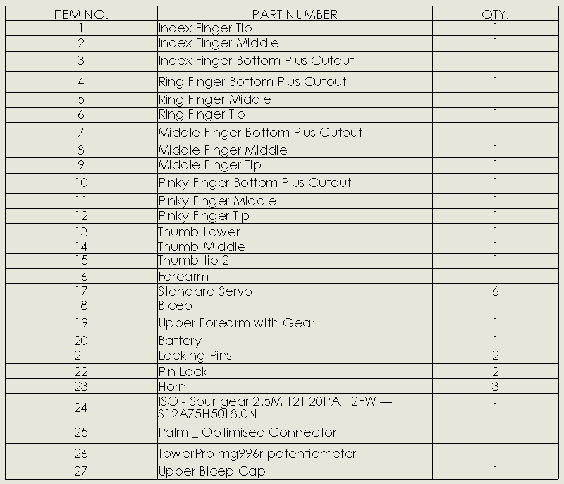
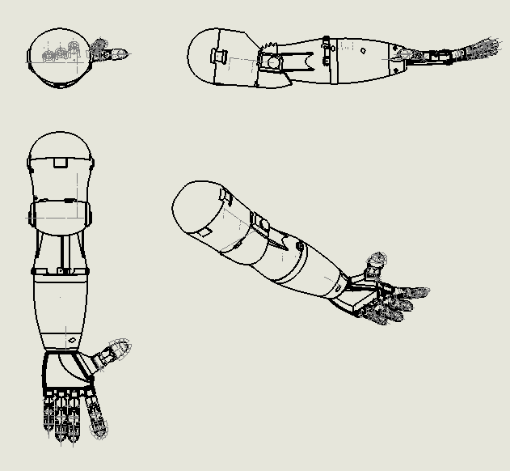
Bill of Material for Assembly

Slide 11
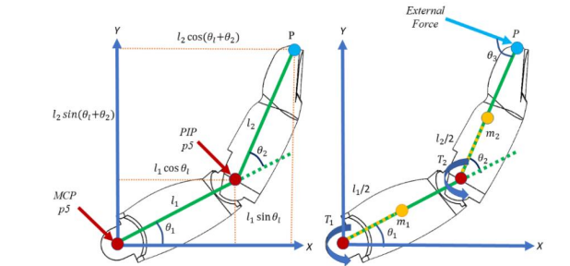
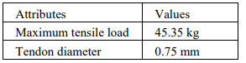
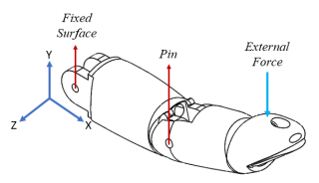
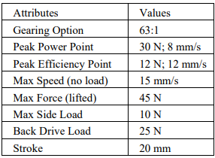
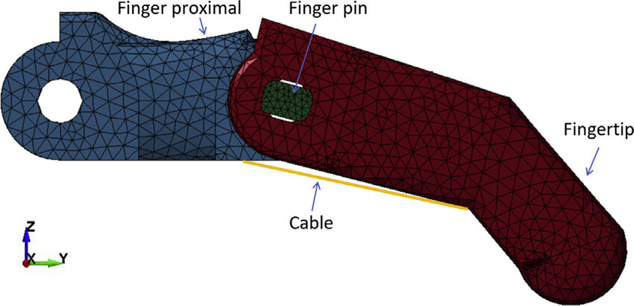
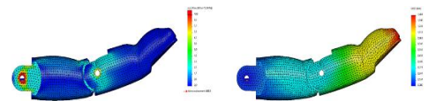
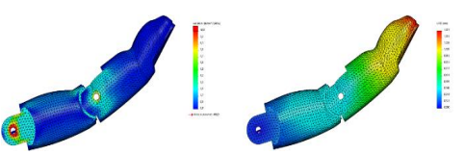
Static Structural Analysis
Kinematic and dynamic finger model
Application of Condition Specification
Specification of Boundary Condition
Stress and displacement graph for different angles.
Meshing of Finger for post processing

Slide 12
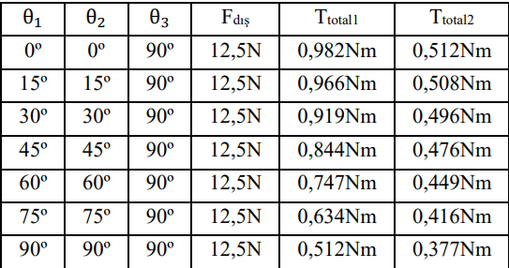
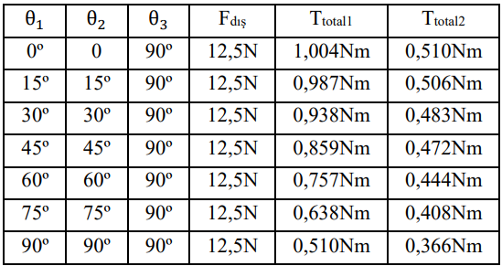
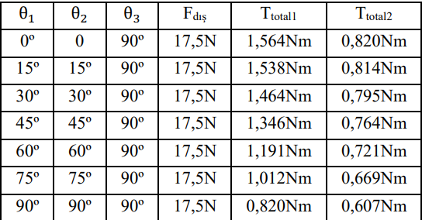
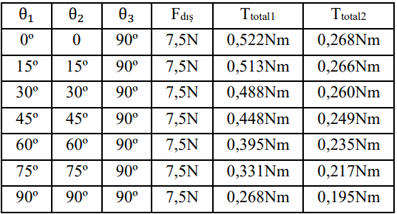
Static Structural Analysis [Contd]
Torque values calculated for index finger
Torque values calculated for the ring finger
Torque values calculated for middle finger
Torque values calculated for the little finger

Slide 13
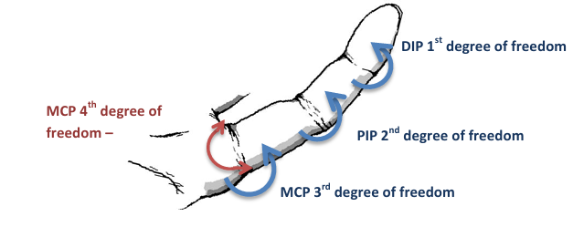
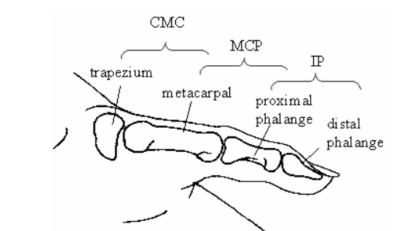
Understanding Hand Movements and Degrees of Freedom (DOF)
Fingers (Excluding Thumb):
MCP (Metacarpophalangeal) Joint
PIP (Proximal Interphalangeal) Joint
DIP (Distal Interphalangeal) Joint
Total DOF per Finger: Four (3 rotational, 1 translational).
Thumb:
CMC (Carpometacarpal) Joint
MCP Joint
IP (Interphalangeal) Joint
Total DOF for Thumb: Five.
Prosthetic Design Challenges:
Accurately mimicking this range and precision of movement.

Slide 14
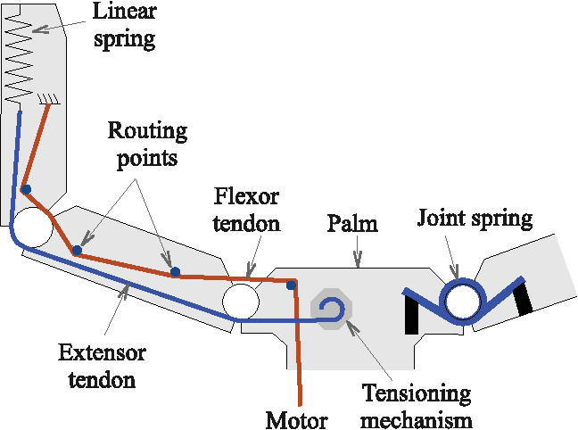
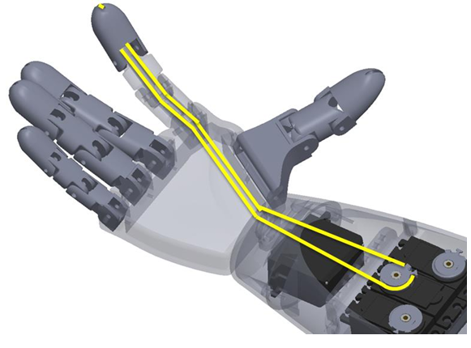
Evolution of Prosthetic Hand Mechanisms
Overview of initial mechanisms using springs
Purpose and mechanism of spring usage in prosthetics
Transition to artificial tendons and servo motors
Introduction to artificial tendon materials and benefits
Servo motors' role in enhancing control

Slide 15
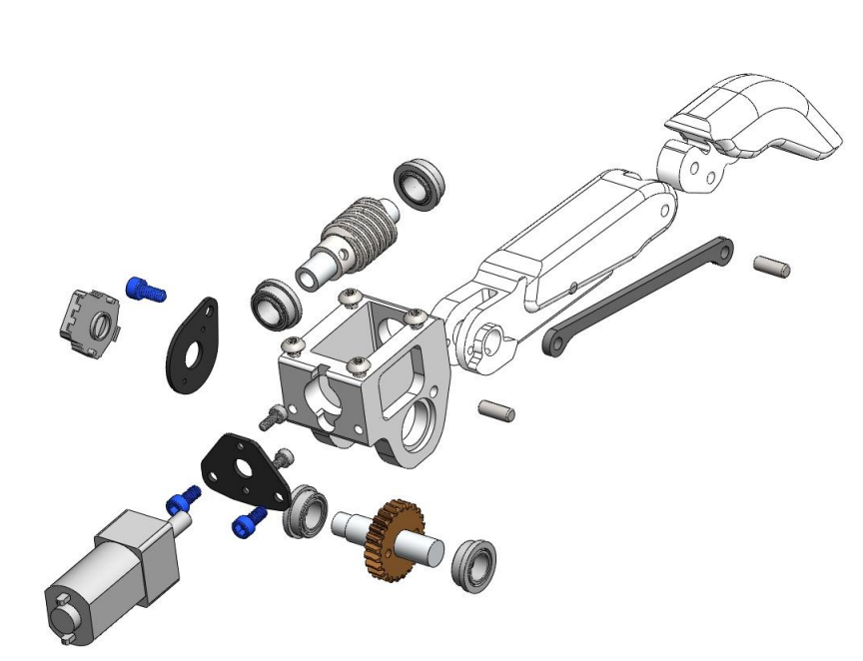
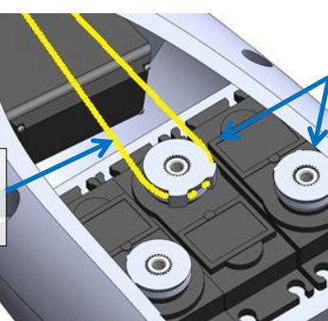
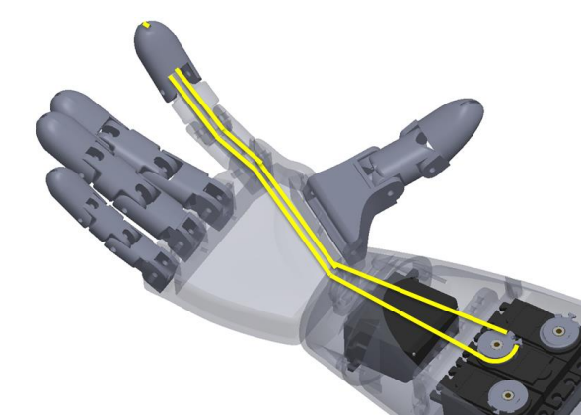
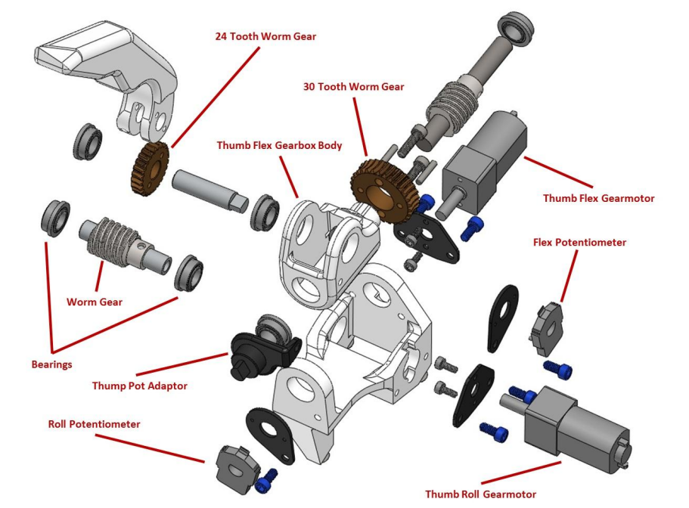
Mechanical Movement
Electric Movement
Integration of servo motors to replicate movements of tendons.
Finger Mechanical Gear Assembly
Thumb Mechanical Assembly

Slide 16
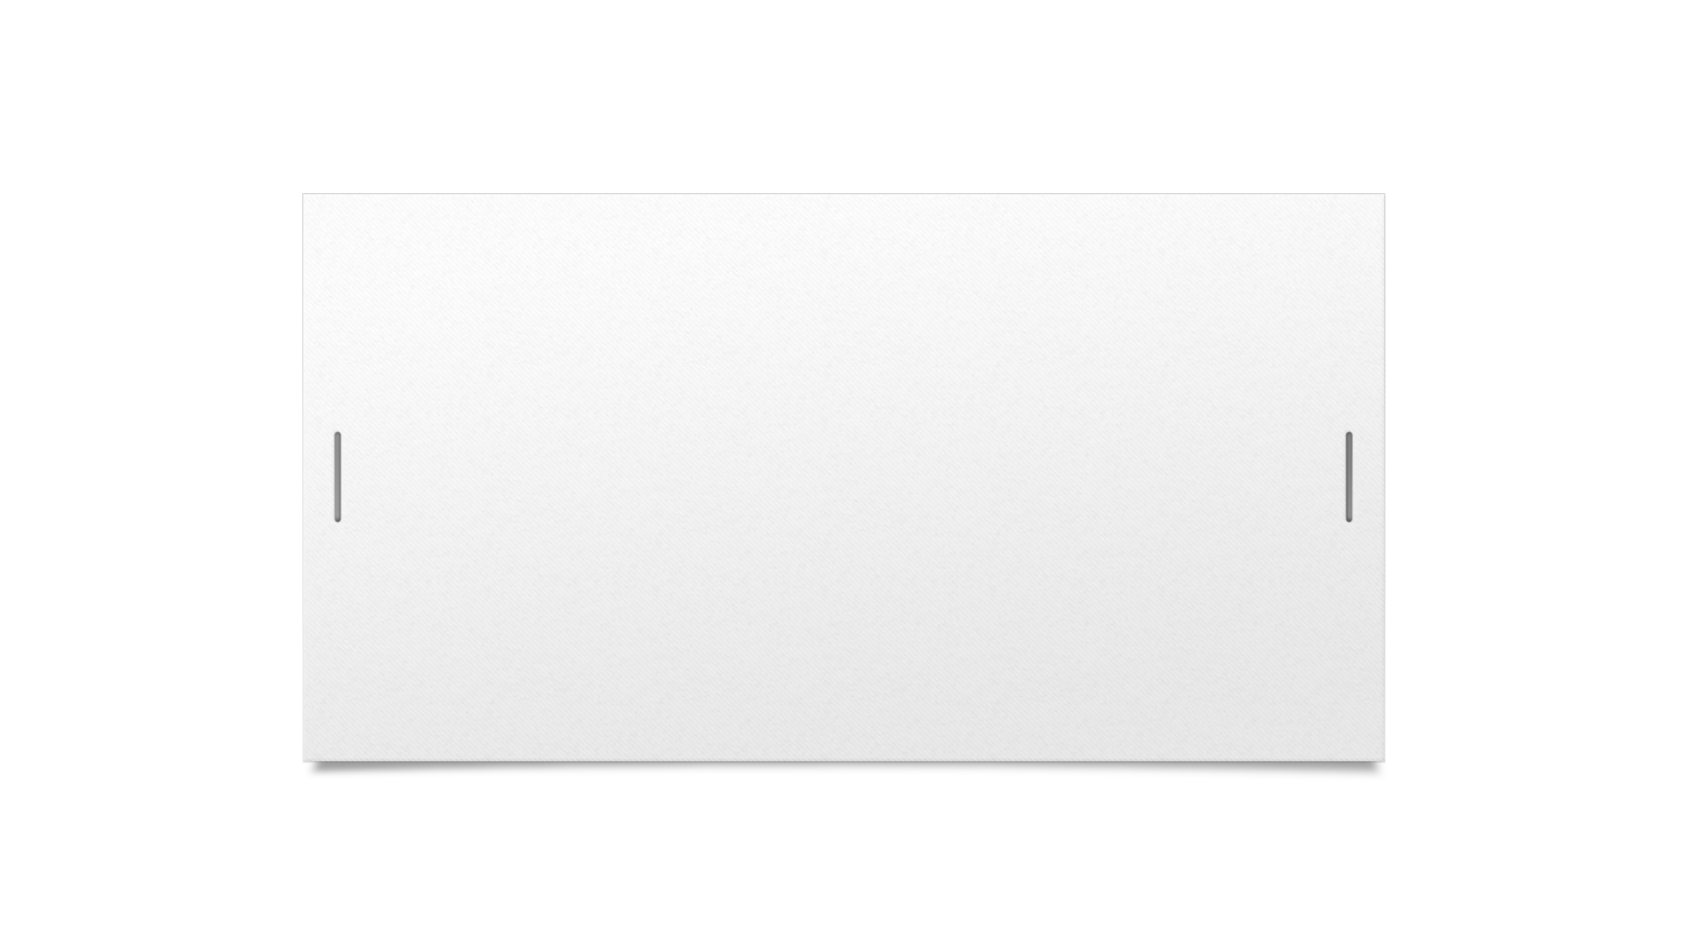
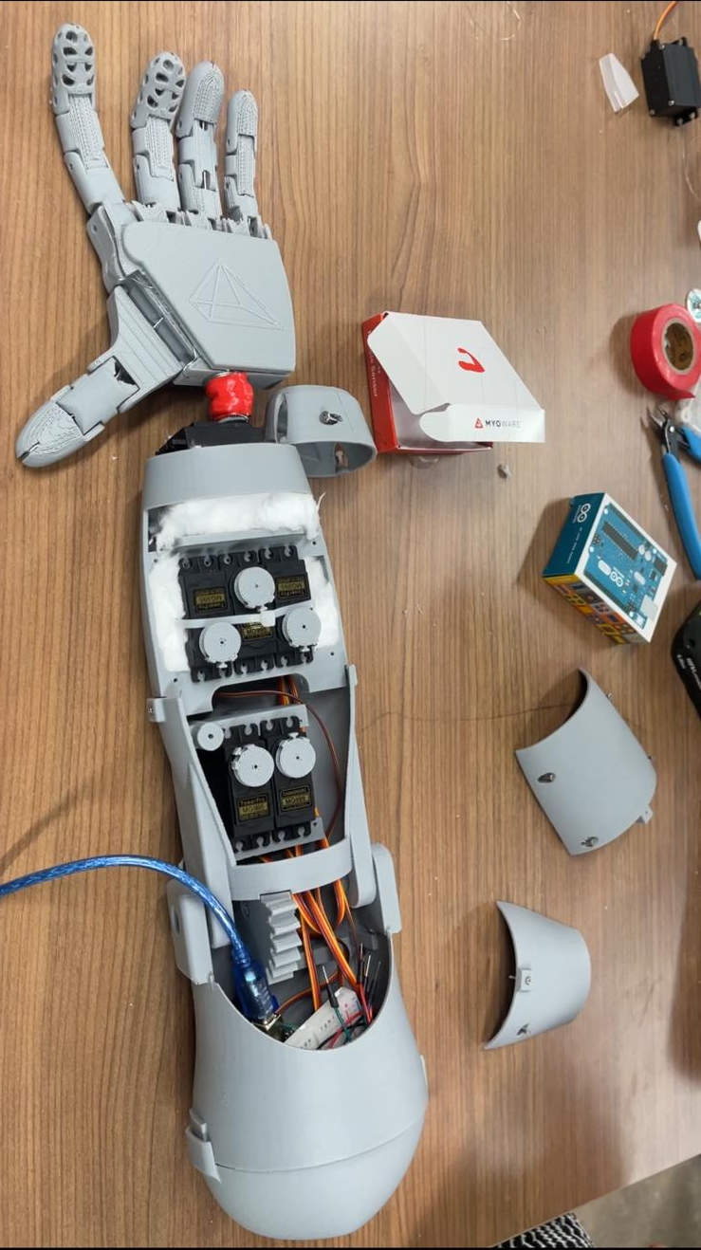

Technical Specifications
Category | Specification | Details/Components
Mechanical Design | 3D Printable Components | Fingers, thumb, palm, wrist, forearm, elbow
 | Actuation Mechanism | Servo motors, artificial tendons
 | Materials Used | PLA for 3D printing
Electrical Design | Control System | Electromyography (EMG) sensing, microprocessors
 | Power Supply | 2 9V battery
 | Circuit Design | Arduino Uno and Voltage regulator
Software & Control | Firmware Implementation | Programming for servo signal control and EMG signal processing
 | User Interface | Myoelectric control through muscle flexing

Slide 17
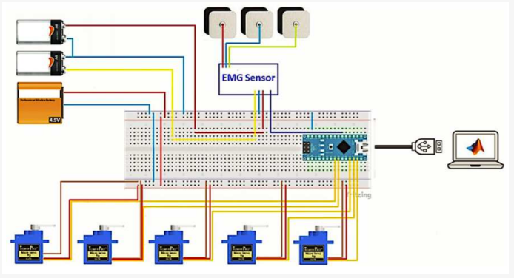


Circuit Design
EMG Sensor connection to Arduino
Entire Circuit Connection

Slide 18

Functional Structure
Feedback
EMG
Process Data
On/Off
Power Level
Electric Power
Receive Energy
Transmit Energy
Discharge Energy
Energy loss
Input power
COMPLETE
Phase
Muscle
Parts
Servo motor
Tendon
Sensor
Signal
Pulling Force
Phase
Exoskeleton
Parts
Outer parts
Working parts
Stopped parts
Moved
Parts
Start working
Finish Working
Sound, Heat

Slide 19
Simulation test
Improve simulation model to check the availability of servo motors’ work
Build artificial tendons and connect with servo motors
Control finger motion by using only the forces from motors(rotating angle)
Able to check only few fingers due to the limitation
Try to make without wire components but model goes heavy rapidly (calculation time: <3sec → >15min for 2 seconds of simulation scenario)
In the case of a single finger, we can check the movements of tendons by using servo motor

Slide 20

Simulation of tendon manipulation

Slide 21

ANIMATED MOMENT FOR GRIP

Slide 22


Slide 23



Actual Testing Phase

Slide 24

Basic structure of the current program
System Insights
System Properties | Description
System Weight | 710g
Material | PLA
Tendons | Nylon Fishing Line
Power Source | 2 9v Battey
Microcontroller | Arduino Uno R3
EMG Sensors | Myowave 2.0 Sensor
Servo Voltage Regulator | AP1117 – 5V output, maximum current 1A

Slide 25

Estimate Costing of Project

Slide 26
References
Upper Limb Prosthetics Market - By Component (Wrist, Elbow, Shoulder, Arm, Terminal Devices), Product (Passive, Body-powered, Myoelectric, Hybrid), End-use (Hospitals, Prosthetic Clinics, ASCs) – Global Forecast, 2023-2032
Design and Fabrication of a 3D Printed Myoelectric Prosthetic Arm
Cyborg beast: a low-cost 3d-printed prosthetic hand for children with upper-limb differences Jorge Zuniga, Dimitrios Katsavelis , Jean Peck , John Stollberg , Marc Petrykowski , Adam Carson and Cristina Fernandez
Hand Functions of Myoelectric and 3D-Printed Pressure-Sensored Prosthetics: A Comparative Study by Kyu Ho Lee, MD, MS, Hobeom Bin, BS, KeunBae Kim, MD, So Young Ahn, MD, PhD, Bong-Ok Kim, MD, PhD, and Soo-Kyung Bok, MD, PhD
Robotic Prosthetics Market Size, Share & Trends Analysis Report By Extremity (Upper, Lower), By Technology (MPC, Myoelectric), By Region (North America, Europe, APAC, Latin America, MEA), And Segment Forecasts, 2023 – 2030
Bray JJ. University of California Los Angeles. Prosthetics-Orthotics Education Program.: Prosthetic principles, upper extremity amputations : fabrication and fitting principles. Los Angeles: Prosthetics-Orthotics Education Program, Division of Orthopedic Surgery, University of California, Los Angeles; 1970

Slide 27


